Slide 1
Identifying variance of features between Manhattan and Toronto
By Rahul S Nair

Slide 2
Use Case
Manhattan and Toronto located situated miles apparat
Establish the relations, similarities, dissimilarities
Top 10 venues for each of neighborhood
Feature Selection

Slide 3
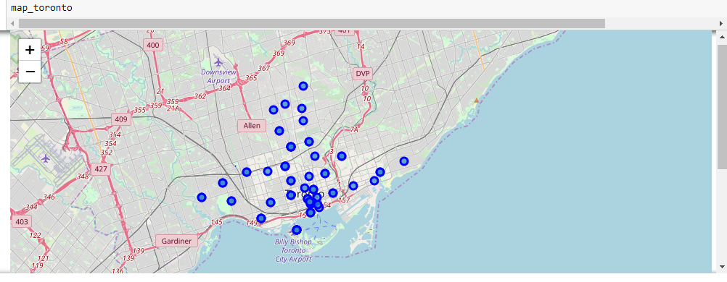
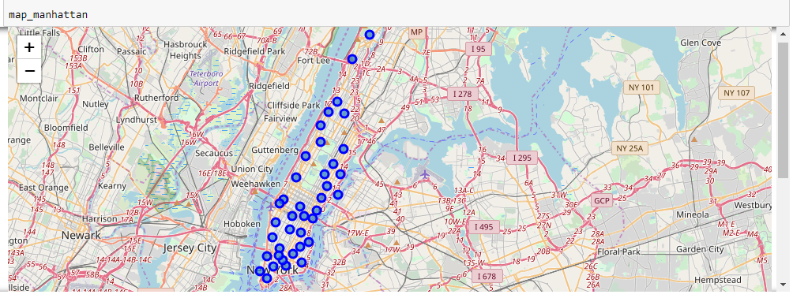
Exploratory Data Analysis
Toronto
Manhattan

Slide 4
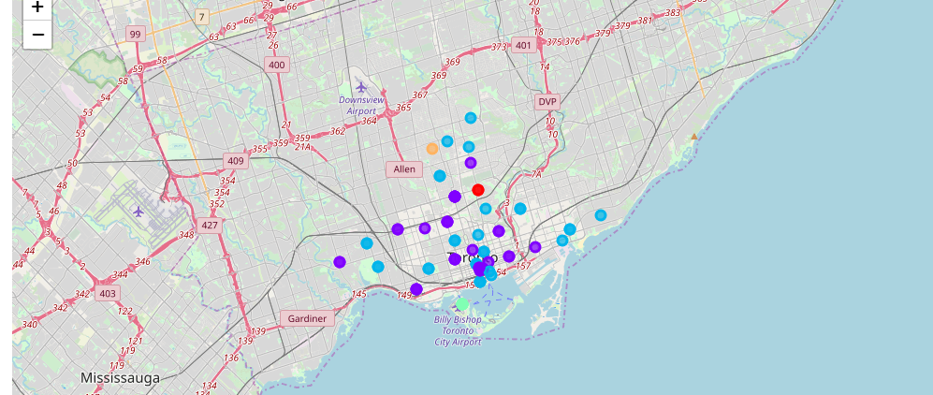
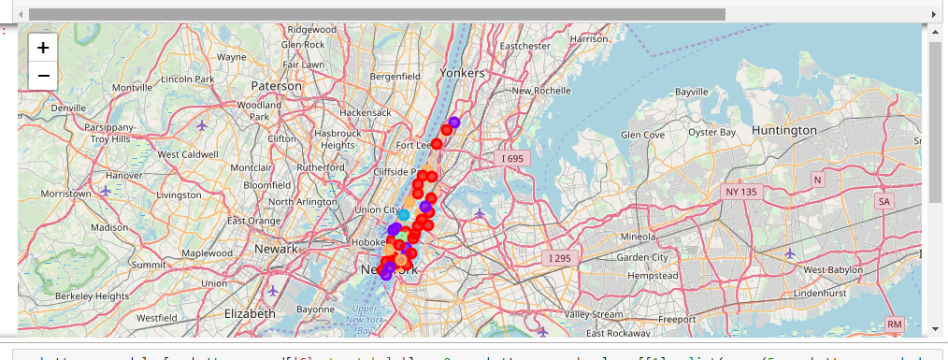
Clustering (KNN)
Toronto
Manhattan

Slide 5
Conclusion
Toronto
More number of coffee shops are present. People tend to drink more coffee
People prefer entertainment venues such as comic book store, parks
Ice cream shops are more in some areas
Manhattan
A Cluster that shows domination on pubs are present.
People prefer entertainment venues such as pubs, parks
Higher number of gym/fitness centers are present

